Slide 1
CS2001 Group project LO1
Group members
Jordan
Yusuf
Nor
Justice
Brandon
abhijeet

Slide 2
brainstorm
Firstly, we talked about different app ideas within our group meetings
Came up with 4-5 appropriate app ideas. However, the flaws in each one were highlighted and apparent.
Discovered we could use fake data; therefore, we decided to proceed with 2 main ideas. One was a Brunel room timetable app, whereas the other was a food ordering app for Yard bird.
Chose Yard bird app because the timetable app was basic in functionality and Yard bird had more possibilities of having unique features and functionalities.

Slide 3
Our app
The app we chose is a takeaway collection app for Yard bird in Brunel University.
Customers will be able to place orders from their devices.
Choose how they want to pay and then collect order (once ready)
Customers can check menu

Slide 4
HCI 7 Principles
After choosing an idea, we researched about the dynamics of a good app.
First, we researched 7 HCI principles
Easy to use
Error free
Secure
Suitable UI
“Don’t reinvent the wheel”
Restrictions
Feedback
After researching these factors, we found other renowned and mostly used or best reviewed applications that supported these principles and

Slide 5
App Research
Whilst researching 7 principles, we found most rated apps in Google store, and wrote what made those apps popular, besides the 7 principles
Additionally, we found apps similar to our Yard bird app idea for features we can implement into our own app.

Slide 6
Prioritising features 1
After our app research, came up with a list of features we wanted to add into our app
Some are very standard but essential and conventional. For example;
Add to basket
Payment(e.g. PayPal, Credit card, Cash)
Simple Menu
Search Engine
Order Tracker
These are the features that are given the priority as they are essential and very much needed by the users.

Slide 7
Prioritising features 2
There are additional features that can be added so to make our app more beneficial to our users
These features include;
Brunel Student Login
App exclusive deals
Product information (Alcohol and Food)
About page

Slide 8
User stories
After deciding these features we then decided create User stories for them and also based off these user stories created simple designs of what the app will look like

Slide 9
User Story Login
Login Page
As a user, I want a username and password to protect my personal information (e.g. credit card credentials), as well as preventing unauthorised access
As a new customer, I want to create an app account to make food orders, in order to avoid queues and get 10% discounts at Yard bird
As a regular user, I want to change my password by the press of a button, in the event I forget my current one

Slide 10
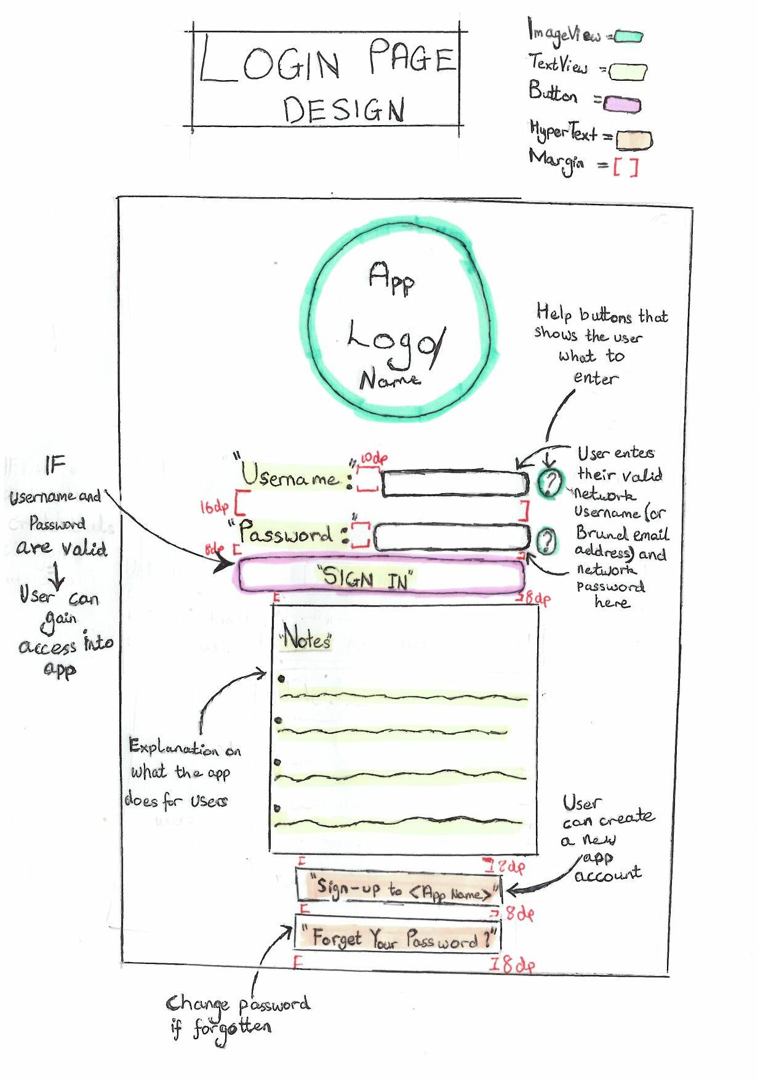
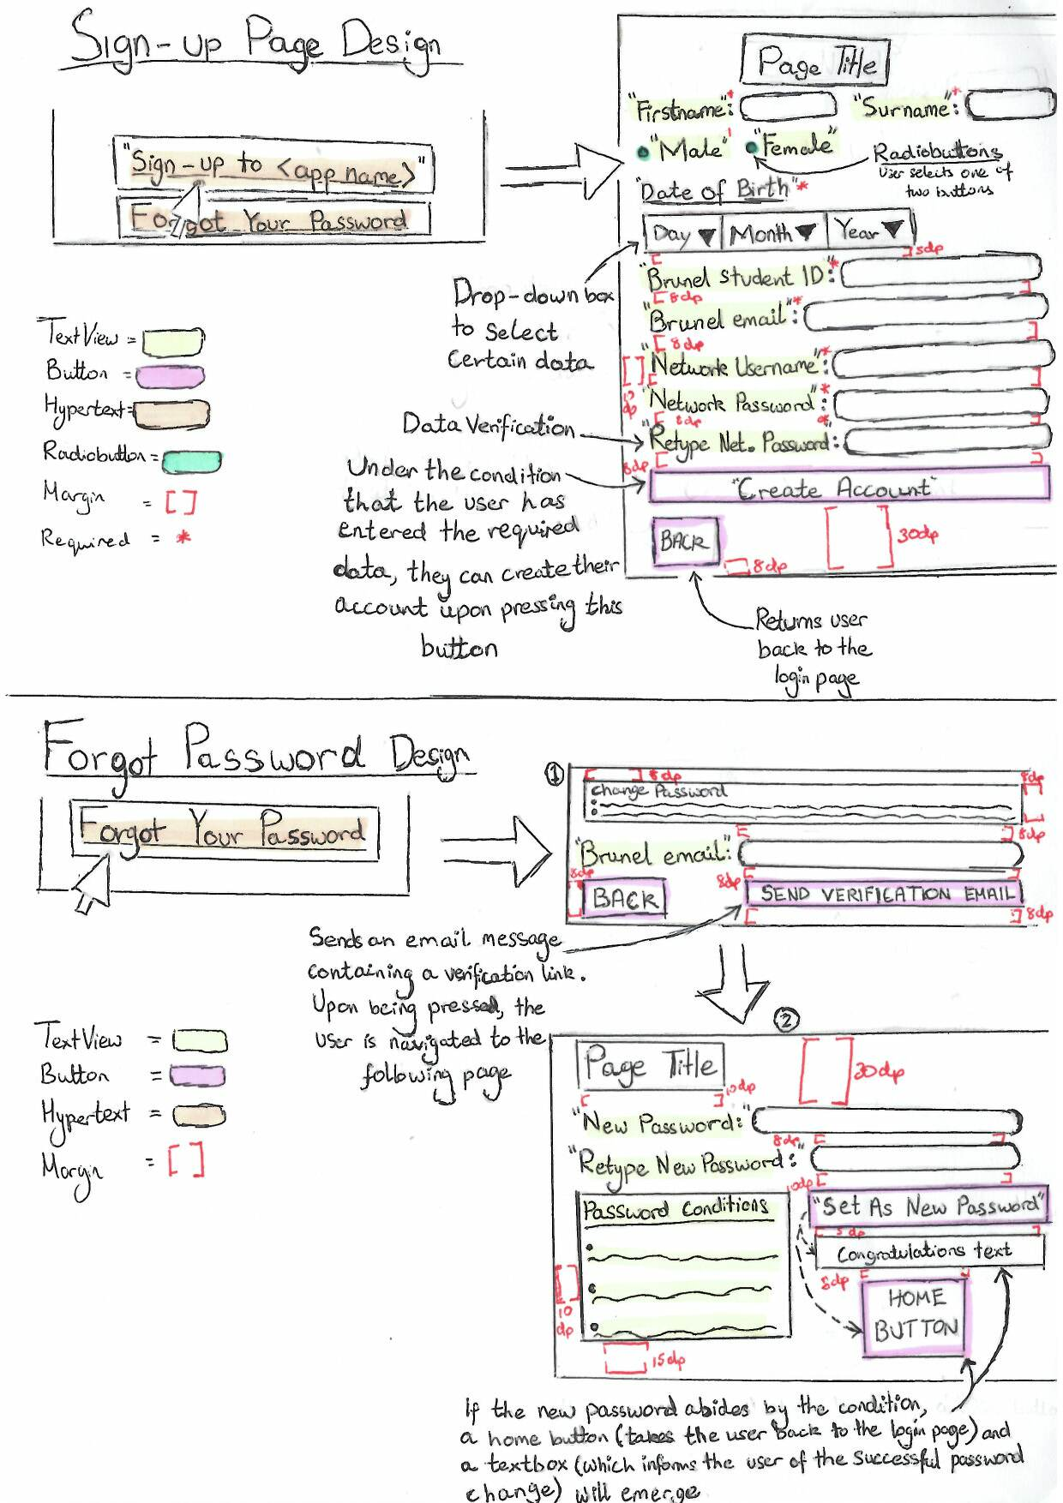
Login, Sign-Up & Forgot Password Page Design

Slide 11
User Story Menu
As a user, I want to view the menu in order to see what to purchase from the Yard Bird outlet. This is because if I’m not by a pc/laptop , I can decide what I want to eat whilst looking at the app. The knock on effect is that I can view this on the go which allows me to carry on with other activities I need to do.
As a user with vision problems, I want to be able to enlarge certain parts of the menu so that I am able to explore what options there are on the menu. This benefits me because I am not excluded from viewing the menu and in turn allows YardBird to have more visually impaired customers.

Slide 12
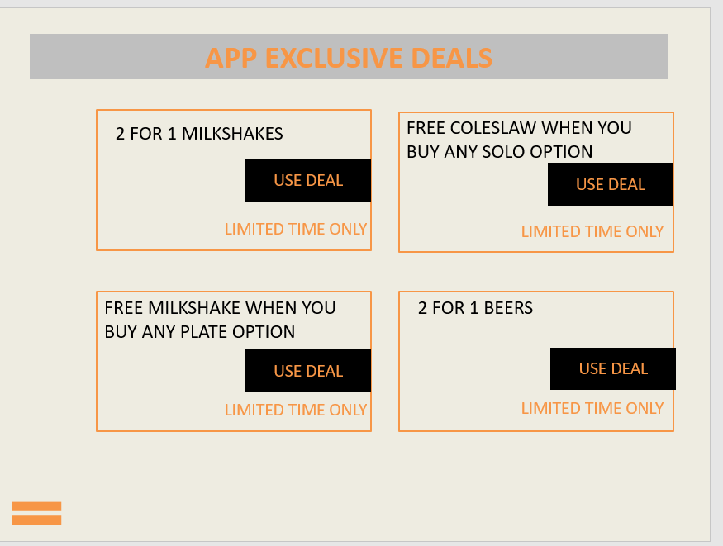
User Story App Deals
As a user I would like to be able to have deals at Yard Bird. This is so that I am able to save money from time to time. Consequently I am more likely to come back to Yard Bird repeatedly.

Slide 13
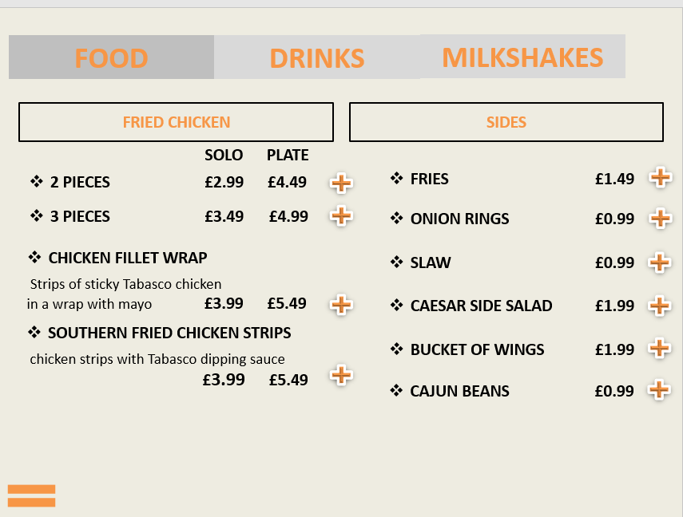
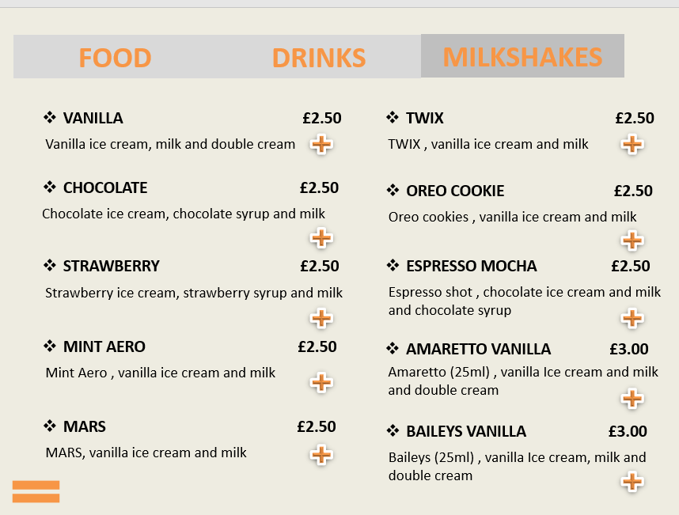
Menu page design

Slide 14
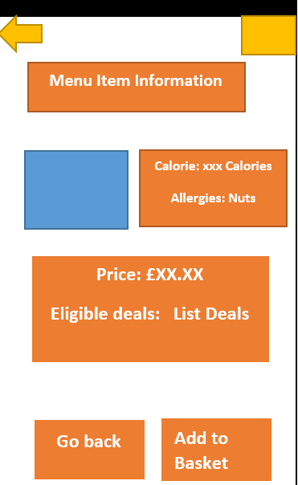
User Story: calories information
As a customer on a diet I want to see what calorie and allergy information there is on each dish to help me choose what I may want to eat.

Slide 15
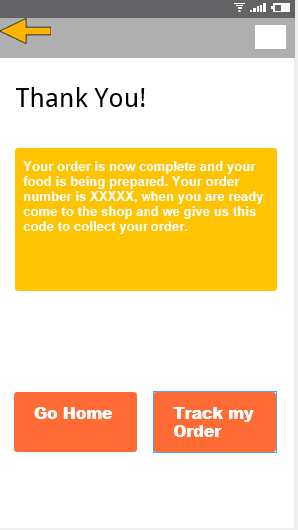
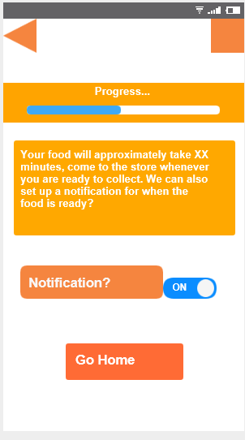
User Story: track order
As a customer I want to be able to track my order to see what stage it is at and know how long it will take to be completed

Slide 16
User Story: Alcohol Page
As a user, I want the alcohol page with an option to filter out the type of alcohol I desire, so that I don’t have to surf through every single product.
As a user, I want the alcohol page to have a search engine as well so that I can simple search for the alcohol bottle, that I want.
As a user, I want the page to display the description of the alcohol bottle for example, type of alcohol and its attributes such as alcohol %, type and availability, so that I will have the desired information that I wanted to know.

Slide 17
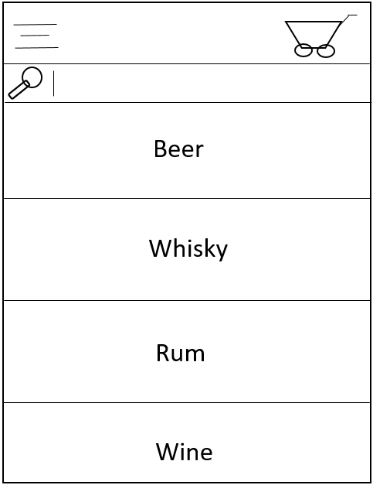
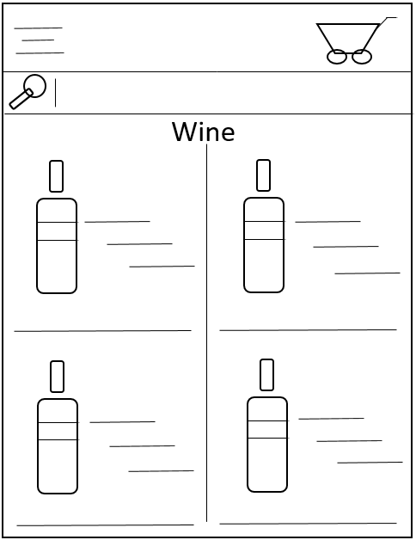
Alcohol Page Design
Filter
Filter
Features and functionalities are to be added such as seen in the image on the left image, such as search engine and alcohol filter engine.

Slide 18
User story: basket page
As a user, I want to be able to view the items I have ordered before payment so that I can confirm I have the right products selected
As a user, I want to be able to view the products I have ordered so that I can make changes, e.g. increase or reduce the quantity of a product or remove a product before making payment.

Slide 19
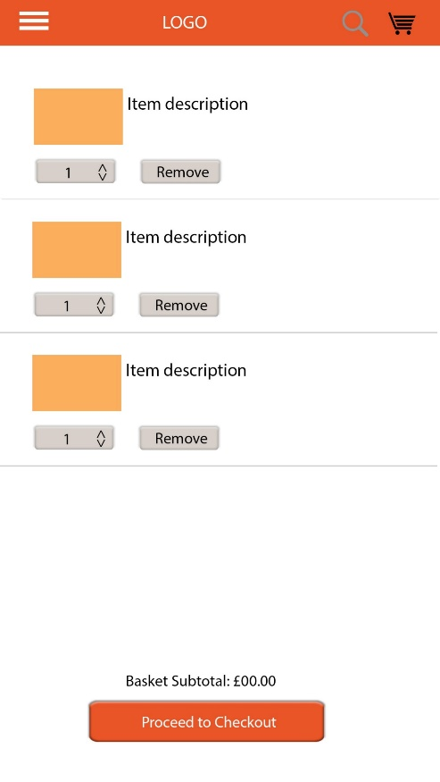
Basket Page Design
On the basket page you can remove items by clicking on the remove button
You can also increase or decrease item quantity of item by clicking the button next to the remove button
The basket page also shows you the subtotal for the items you have selected so you know how much it cost before making payment.

Slide 20
User Story: Payment
As a user I want to make a payment by card to easily pay for my order.
As a user I want to make a payment using my Paypal account to pay for my order.
As a user I want to pay by cash when collecting my order.
As a user I want to ensure my card details would stay secured when paying for my order to prevent unauthorised access.

Slide 21
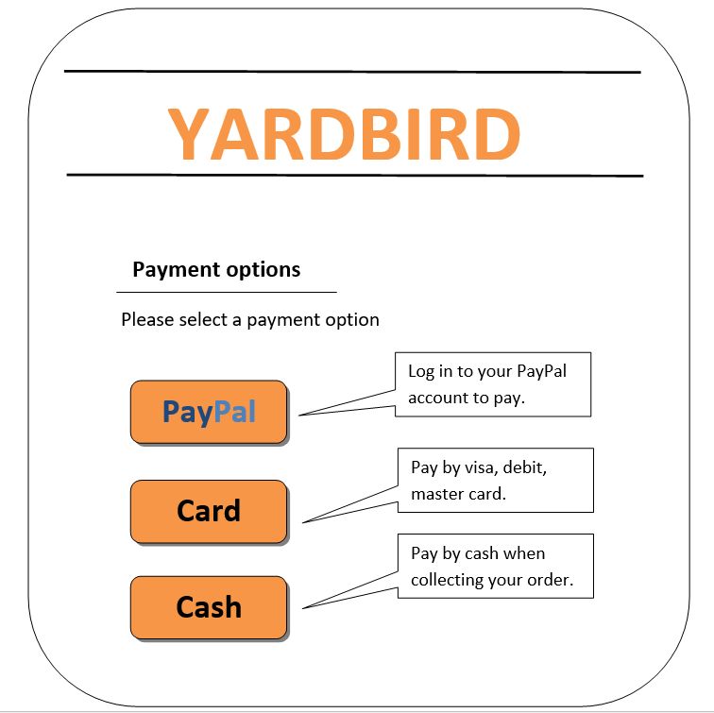
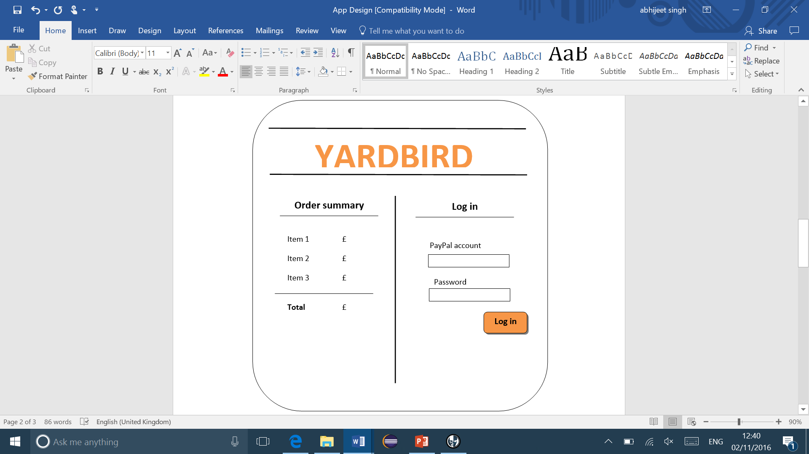
Payment page Design 1

Slide 22
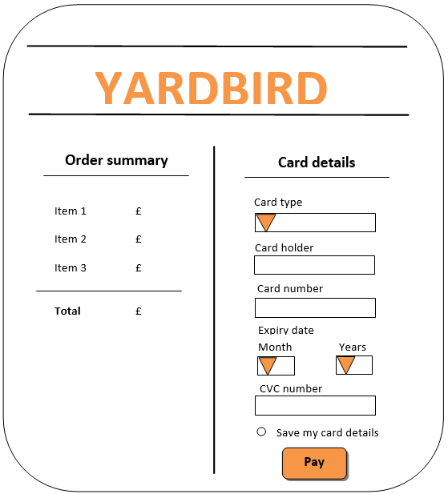
Payment page Design 2

